Slide 1
Atomic Notation Review
Charge (if it is an ion)
(If no charge is shown it is neutral)
Mass # (p⁺ + n⁰)
Number of atoms (if in a formula)
(If no # is shown, there is just one)
Atomic # (# of p⁺)

Slide 2
Ch 2 & 3 - Outline
The Bohr Model of the Atom
The Quantum Mechanical Model
Determining Electron Configurations

Slide 3
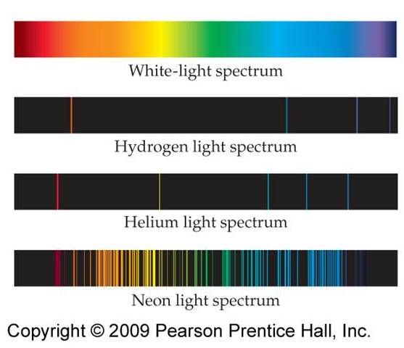
Atomic Emission Spectra
When chemists put different elements into a lamp different colored lines were observed.

Slide 4
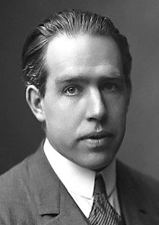
A New Atomic Theory
In 1913, Chemist Niels Bohr proposed a new theory of the structure of the atom.
His theory explained the source of the individual spectral lines- specifically for the hydrogen atom.
en.wikipedia.org/wiki/Niels_Bohr

Slide 5
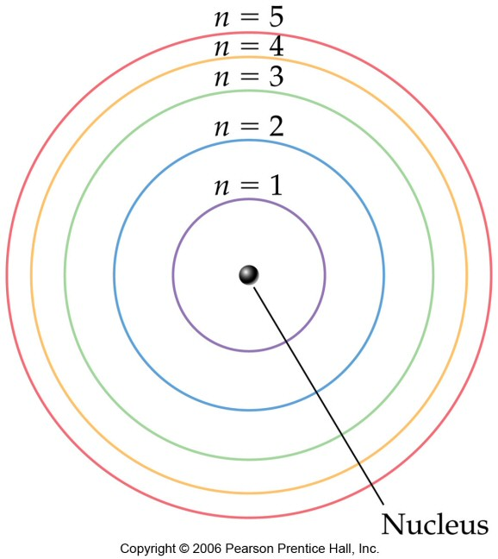
The Bohr Model
Electrons travel in orbits (“shells”) around the nucleus.
Higher level shells are higher potential energy.

Slide 6
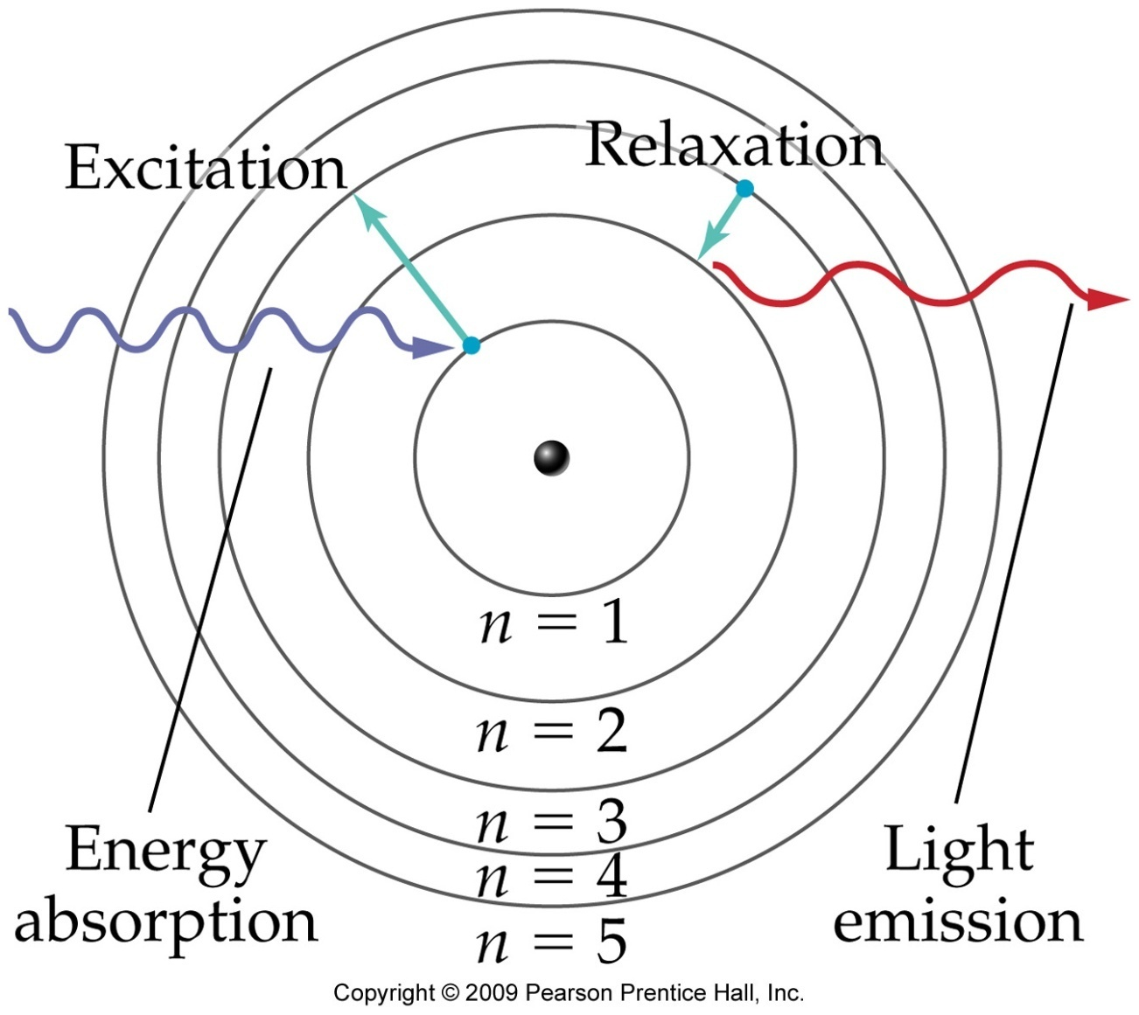
The Bohr Model
Electrons can move to higher shells by absorbing energy.
When electrons fall to lower shells they release energy as light.

Slide 7
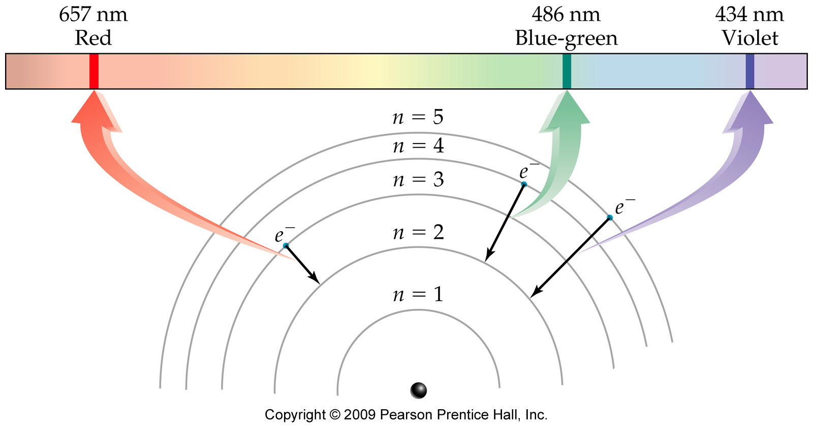
The Bohr Model
The energy of the light emitted corresponds to the energy difference between shells.

Slide 8
Outline
The Bohr Model of the Atom
The Quantum Mechanical Model
Determining Electron Configurations

Slide 9
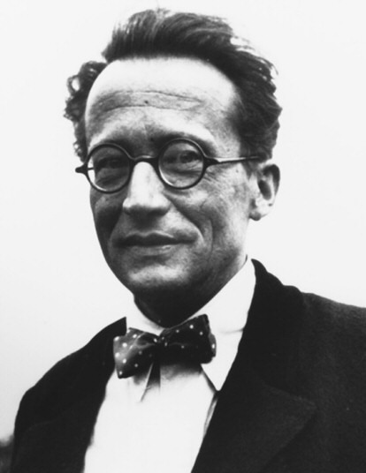
The Quantum-Mechanical Model of the Atom
Erwin Schrödinger applied the mathematics of probability and the ideas of quantizing energy to the physics equations that describe waves, resulting in an equation that predicts the probability of finding an electron with a particular amount of energy at a particular location in the atom.

Slide 10
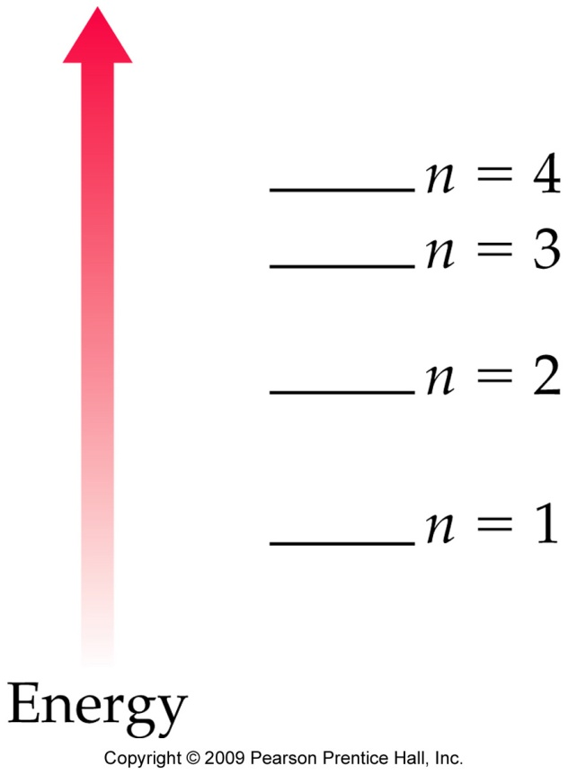
The Quantum-Mechanical Model: Orbitals
The result is a map of regions in the atom that have a high probability for finding the electron.
We call these regions orbitals.
The principal quantum
number (n) specifies the main
energy level for the orbital.

Slide 11
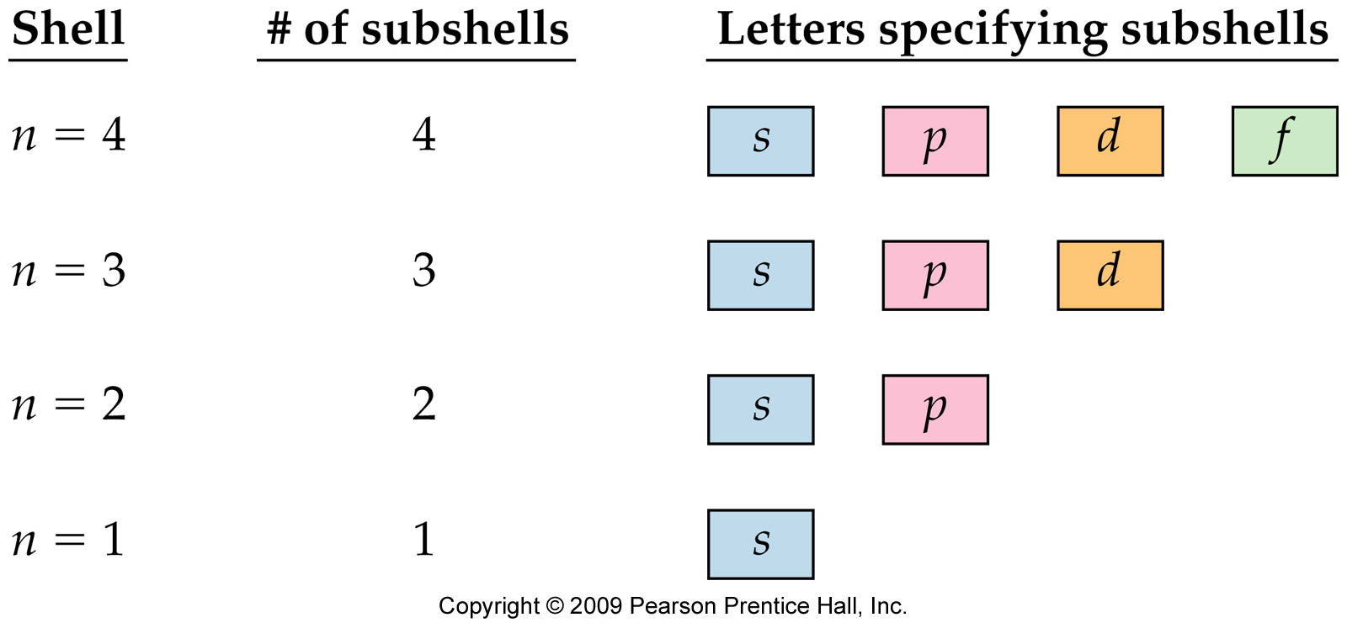
Shells and Subshells
Within each shell there are subshells designated by the letters s, p, d, and f.

Slide 12
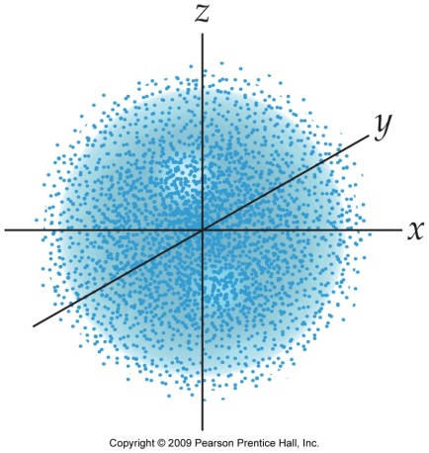
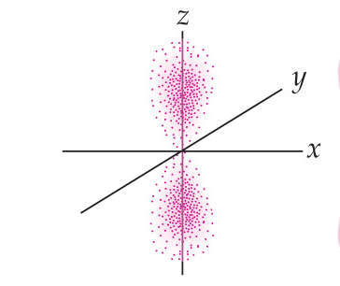
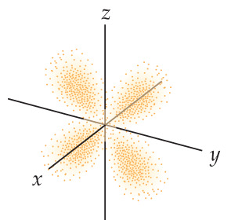
Shells and Subshells
The subshells are regions where there is a high probability of finding an electron.

Slide 13
Subshells and Orbitals
Each subshell contains a different # of orbitals.
s subshells have 1 orbital.
p subshells have 3 orbitals.
d subshells have 5 orbitals.
f subshells have 7 orbitals.
Each orbital is a region that can contain 2 electrons (spinning opposite directions).

Slide 14
Energy
6d
7s
5f
6p
5d
6s
4f
5p
4d
5s
4p
3d
4s
3p
3s
2p
2s
1s

Slide 15
So, what does this mean?
This means that we can essentially determine a region where each electron will be in an atom.
This is called the Electron Configuration

Slide 16
Outline
The Bohr Model of the Atom
The Quantum Mechanical Model
Determining Electron Configurations

Slide 17
Steps to Determining an Electron Configuration
Draw the Electron Configuration Diagram
Count the total number of electrons in an atom.
Fill in the diagram according to the following rules.
Start at the lowest energy and fill up (Aufbau Principle)
Put a maximum of 2 electrons in each orbital, spinning opposite directions (Pauli exclusion principle).
When there are multiple orbitals at the same energy level put one in each first, spinning the same direction, before pairing electrons. (Hund’s Rule)
* For Cations, fill the total number of electrons in the neutral atom first, then remove electrons from the highest numbered shell first, to get to the appropriate charge.

Slide 18
Group Exercise (Periodic Table and Electron Config)
Color s, p, d, f orbital blocks on periodic table
On left side, note row numbers (n)
By d-block, note “n-1”, by f-block note n-2
Write electron configuration of Fe by following orbital blocks
Answer the following questions quickly without doing full electron configuration.
How many 3p electrons are in Selenium?
How many d electrons does chromium have
How many valence/outer shell (s&p electrons)does silicon have?
How many unpaired electrons does sulfur have?

Slide 19
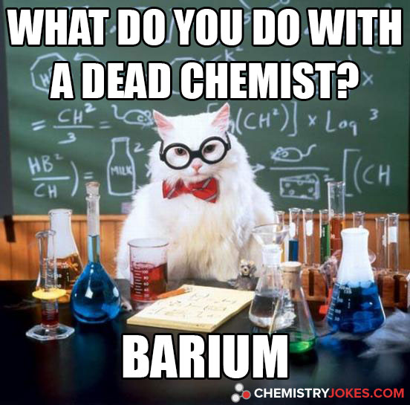
Chemistry Joke

